Slide 1
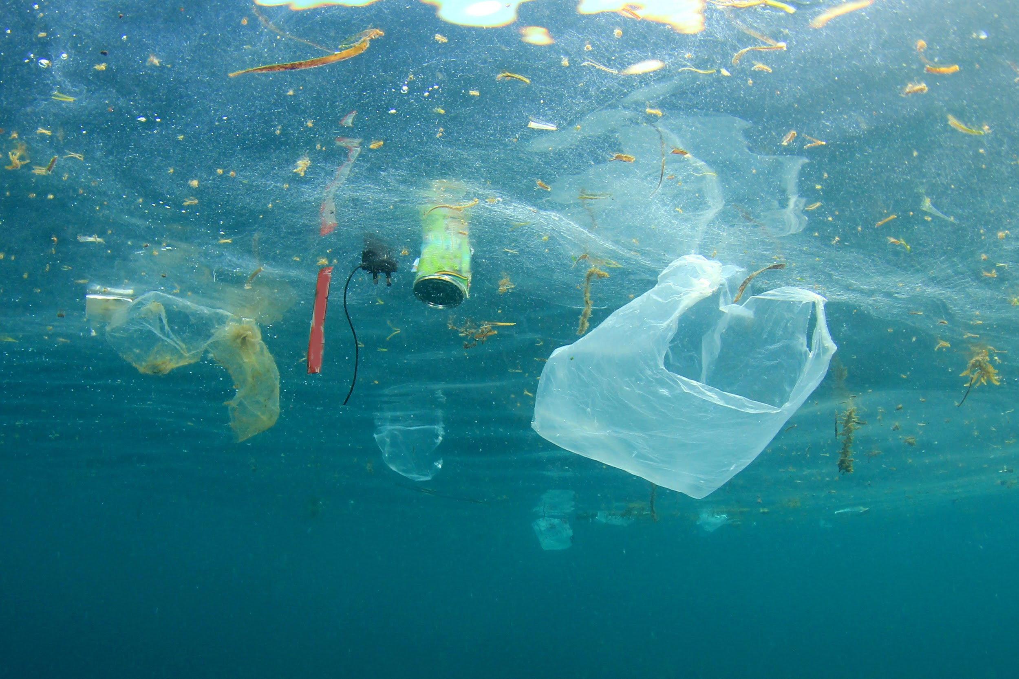
Rubber Duck Solutions
Jonathan Vargas & Carter Brezinski
Notes:
Carter & Jon
10s max

Slide 2
Table of contents
Who are we? What experience do we have.
What the problem we’re looking to solve.
How we aim to solve it.
Input & advice going forward.
Notes:
Jon: 20-30s

Slide 3
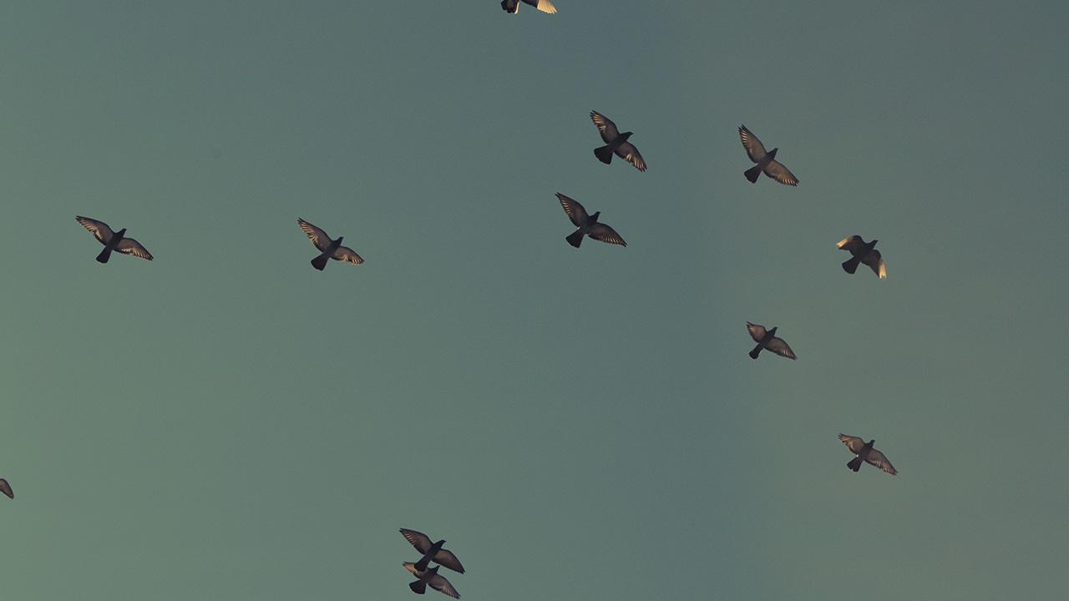
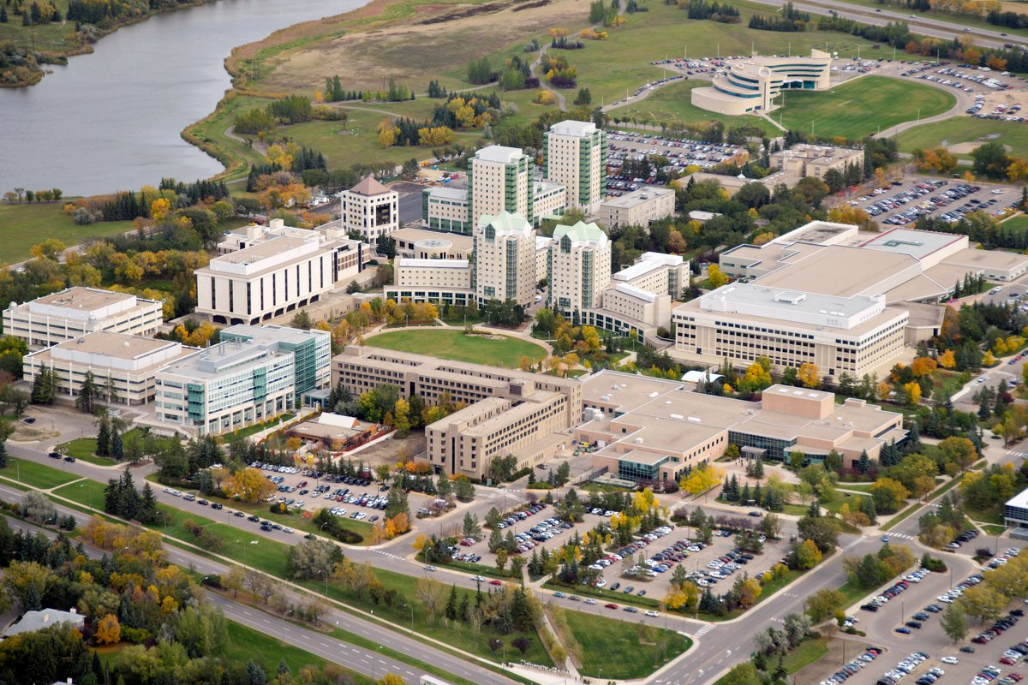
Who are we?
Notes:
Carter & Jon At this current point in time, based on my background I see myself taking the role of _________ Backend lead, Specializing in machine learning/developing the Artificial Intelligence that we will be working with for this project.
And I see myself as Frontend lead, project manager

Slide 4
The problem?
5,250,000,000,000
Pieces of macro & micro plastics in the ocean.
Notes:
Carter:
plain and simple, our hope and our goal for this project is to be part of the bigger solution that brings that number down.
Many projects are doing an excellent job at removing the surface plastics, our hope is to document plastics that are just below the waters surface.

Slide 5

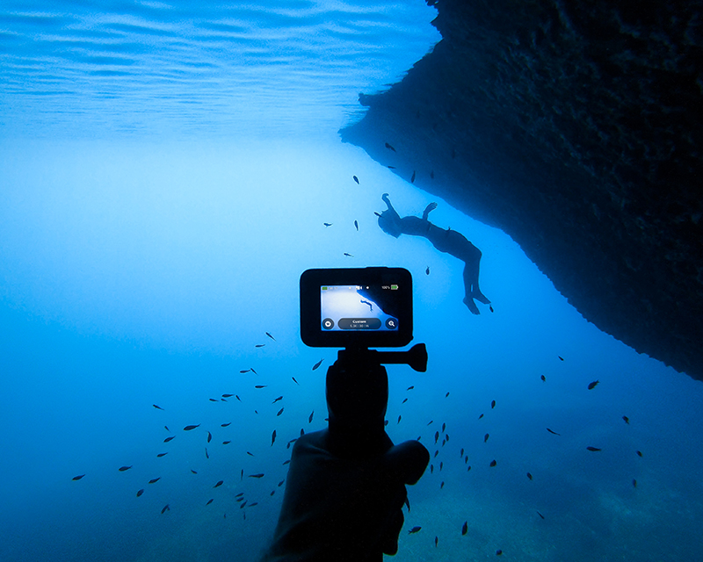
Our solution
Our initial idea was to use a live feed from a GoPro camera, that would relay video information back to a computer. We would need to design a rig or system for the GoPro to operate functionally in.
Notes:
Jon: We did do some quick research and we have found numerous of projects and articles of technology, surveying the surfaces of bodies of water for floating litter. We wanted a more in DEPTH view of waste that was lingering around a bit deeper than the surface. One of our initial ideas was for a live video feed system that would allow a user to manually record any waste floating beneath the surface.
30s

Slide 6
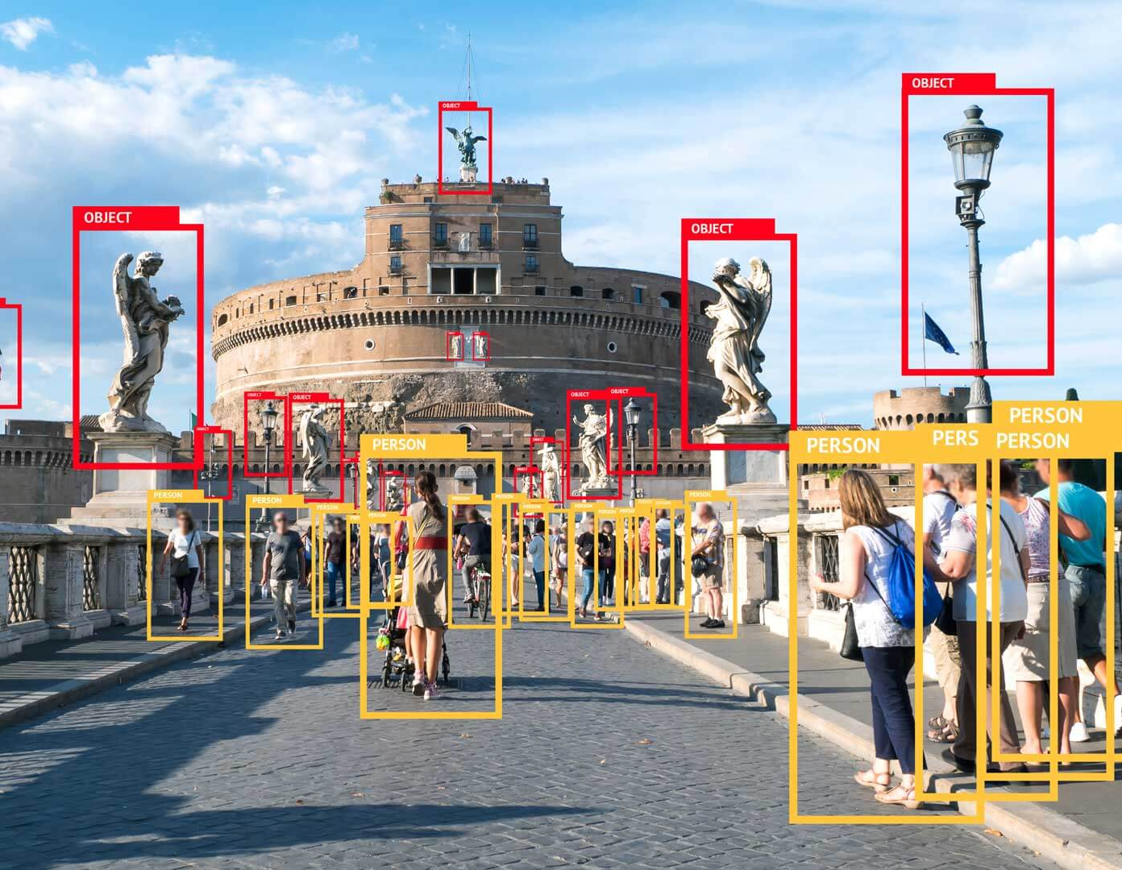
Our Solution
From that video feed, we would run it through an image recognition software, to determine what is garbage, water, fish, etc.
Place your screenshot here
Notes:
Jon: 30s So we propose an image recognition AI system that will identify any foreign objects a few feet underwater. Ideally this will be able to pick up any plastic/ aquatic creature and ignore any nature features such as coral, rocks, and moss. When it detects litter the system will take a picture for documentation..
- This obviously will be the portion that Carter focuses on. EASY EXTRA TIME

Slide 7
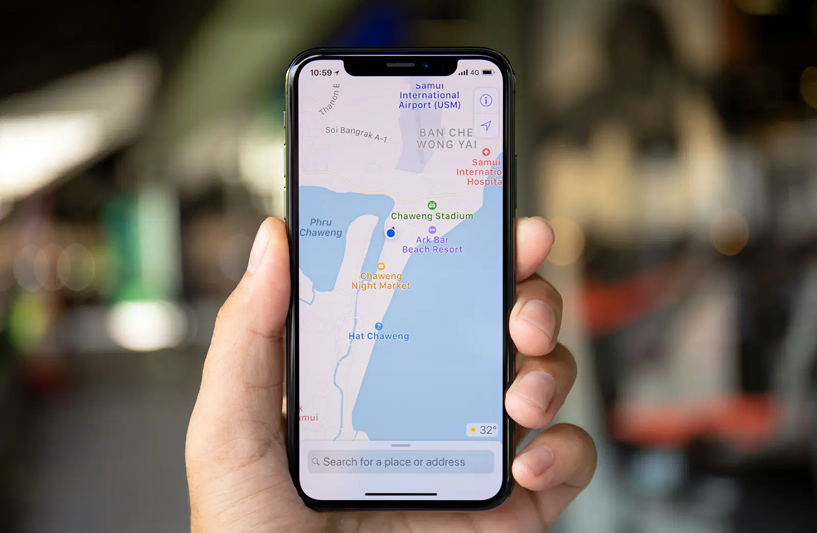
Application support
Place your screenshot here
We would like some form of a front end.
That could be a mobile application, a browser source, or some other form of live feed documentation.
Scope permitted, this may also include a geolocation.
Notes:
Jon: To display the data that our system gathers we aim to build a web application to track when any garbage has been detected and around what vicinity was it located.
- This obviously will be the portion that I myself will focus on. EASY EXTRA TIME

Slide 8
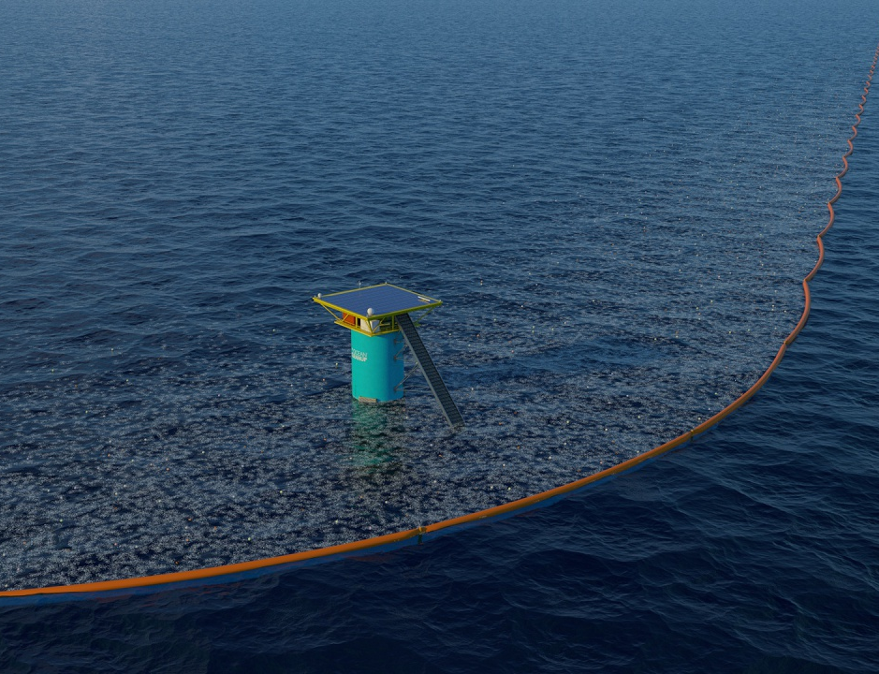
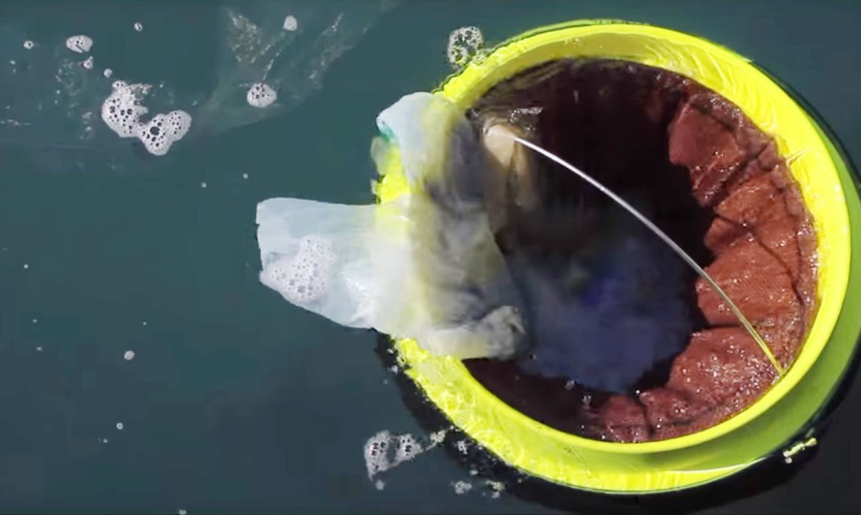
Who might this be useful for?
Who is our target audience?
There are many different companies who are actively working to clean ocean waters and local waters. There are many solutions already pre-existing for cleanup.
We want to focus more on waste detection and documentation so that it can be cleaned up later.
Notes:
Carter:
30s

Slide 9
The Scope of our project
Regina
Notes:
Carter:
As it’s very evident on the world map, we aren’t near any large bodies of water. So testing our project in ‘ocean water’ is going to be difficult.
Not only are we a landlocked province, but typically we experience snow and nonideal weather conditions for about 6 months of the year.

Slide 10
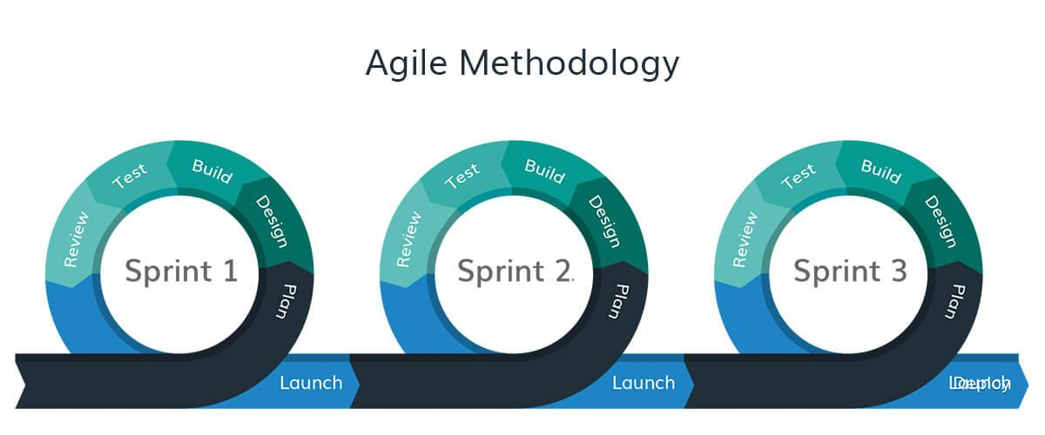
Things that we understand going into this project
Testing will pose to be a difficulty due to location, weather, and conditions.
It won’t work the first time, there will have to be many reevaluations.
Notes:
Carter
Once we have developed our project to a working state we will most definitely have to follow an agile methodology. Refactoring our design where it is necessary after each testing phase to improve the quality of the design.

Slide 11

Questions, Comments, Concerns
Scope, Idea, Resources, Timeline
Notes:
Repository uti?a tonne of data
Train up to n %
Does it cover in the problem domain
Is the water clear or
freeze

Slide 12
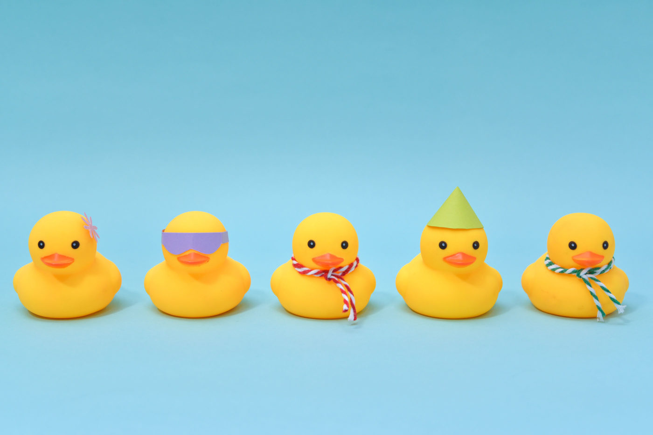
Thank you for listening

